Slide 1
BUSINESS PROCESS ENGINEERING
Sobia Iftikhar

Slide 2
Content
Business Process Outsourcing

Slide 3
BPO
Business process outsourcing (BPO) is a business practice in which an organization contracts with an external service provider to perform an essential business function or task.
TO fill in the gap and ensure a smooth business operation, many organization turn to business process outsourcing also known as BPO.

Slide 4
What Is Business Process Outsourcing Services And Solutions Providers Used For?
Back-office operations: These comprise the processing of payments, IT support, quality control, etc.
Front office activities: These include marketing, sales, dealing with clients, and handling complaints.

Slide 5
Types of Business Process Outsourcing Services And Solutions Providers
Business Process Outsourcing Services companies can be divided into three types based on their location:
Onshore outsourcing: When a company works with a service provider based in the same nation. Another name for it is domestic outsourcing.
Nearshore outsourcing: When a company employs a service provider in a nearby nation.
Offshore outsourcing:When a company employs a service provider in another nation. Another name for it is offshore.

Slide 6
The Risks of Business Process Outsourcing
Security
Underestimating the costs of services
Overdependence on service providers
Communication issues

Slide 7
Survey
The global market size of services outsourced from the United States was $88.9 billion in 2017 and is expected to hit $140.3 billion by 2022, as reported by Statista and The BPO Services Global Industry Almanac 2017 Company Report. This was after steady growth of 4.4 percent compounded annually from $45.6 billion in 2000.

Slide 8
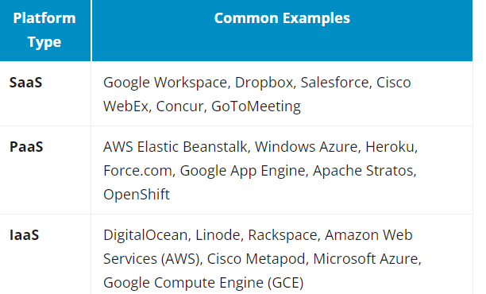
Common examples of SaaS, PaaS, & IaaS
IaaS is there to provide you with maximum flexibility when it comes to hosting custom-built apps, as well as providing a general data center for data storage.
PaaS is most often built on top of an IaaS platform to reduce the need for system administration. It allows you to focus on app development instead of infrastructure management.
SaaS offers ready-to-use, out-of-the-box solutions that meet a particular business need (such as a website or email). Most modern SaaS platforms are built on IaaS or PaaS platforms.

